Slide 1


Quantum Communications Group
Weekly report
Group Coordinator:
Armando Nolasco Pinto
anp@ua.pt
Diogo Matos - 27/09/2023
Group Websites:
https://www.it.pt/Groups/Index/72
LinkedIn: https://www.linkedin.com/company/quantum-communications-group-it-av/

Slide 2
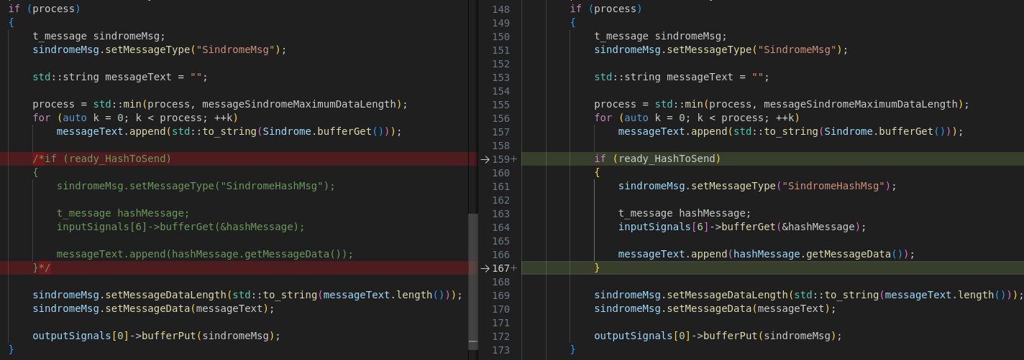
QOKD multi-machine
Compilation and current execution (with some errors in the resulting keys) in the branch feature/cv_qokd_ldpcmultimachine_ubuntu;
Same project compiled but did not executed as expected;
The problem is due to the includes.;
After a trial error process, the file causing the error is dv_qkd_ldpc_tx_message_processor_transmitter_20200819.cpp
The diff between the correct file and the one currently in the repository are minimal (hash related)

Slide 3

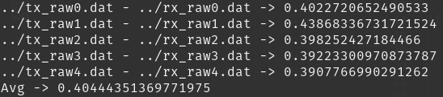
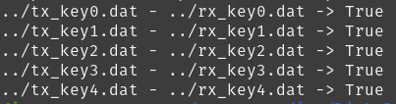
QBER and oblivious key pair test scripts
Written in Python with no use of extra libraries;
Tests results using the raw keys currently in the repository
QBER
key pair test

Slide 4
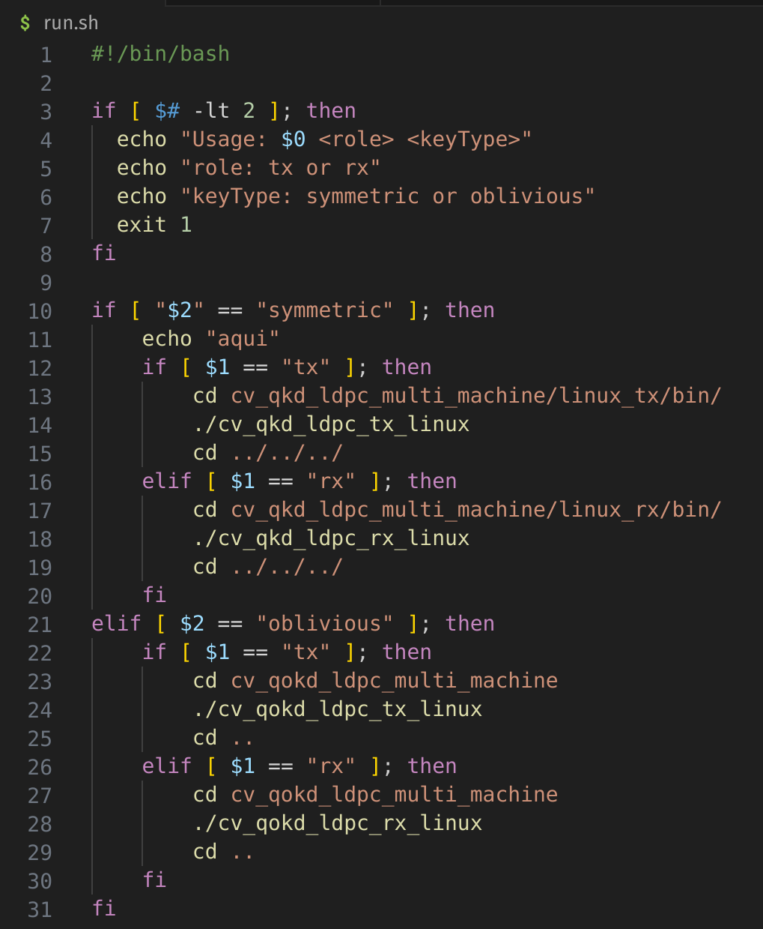

Symmetrical and oblivious execution script
After compilation, run programs like:

Slide 5
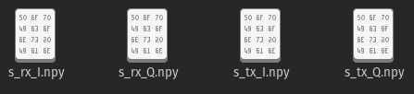
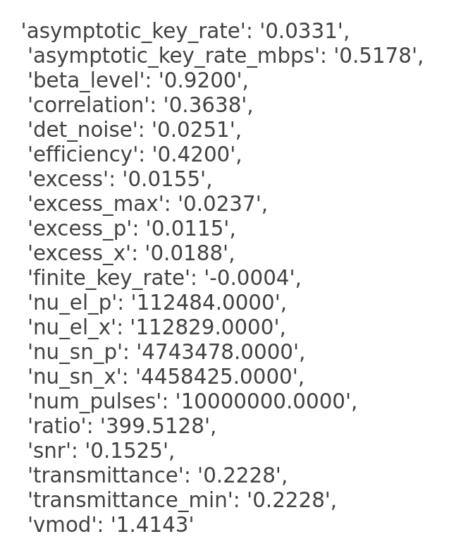
ICFO raw keys test
Files with in-phase and quadrature components for Bob and Charlie;
Transformation to binary does not seem to be trivial;
Nelson Muga told me to talk with Margarida Almeida.

Slide 6
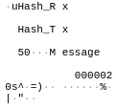
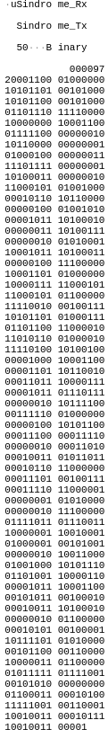
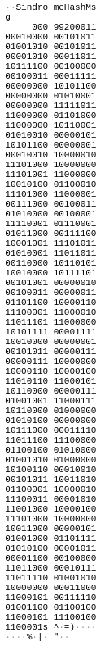

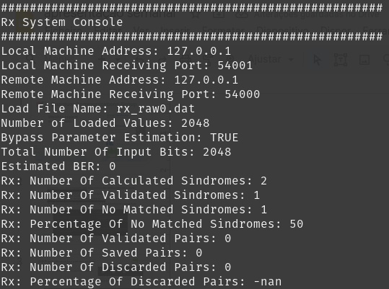
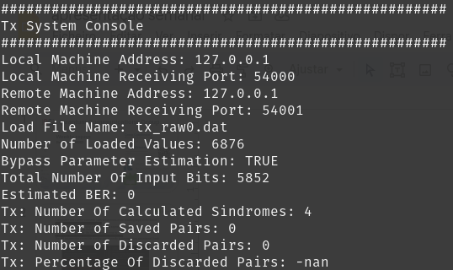
Cv qokd ldpc new message handler
The message handler are replacing the processor_transmiter/receiver that have inselfs some logic associated with message type;
Sindrome_hash messages are being divided since into two messages. A bundle functionality in the message_handler was added;
Síndrome reconciliation module is not sending expected output signal.
Hash msg
Expected msg from Tx to Rx
Rx freeze
Tx freeze
Síndrome msg
Expected msg

